Slide 1
Case Study - NBA Fan Engagement
Wai Hoi Li
Hult International Business School - MsBA Cohort 2
Text Analytics and NLP

Slide 2
Agenda
Problems to answer
Methodology
Most talked team
Emerging topic

Slide 3
Problems to answer
What are the most talked about teams, and is the popularity related to any social topics and trends, or simply just because they are playing?
What are the categories of those topics that related to the NBA, or the teams in general?
Are they mostly basketball sector related? Or is there any subtle categories of these trendy topics?
Who are the top 3 talked about players in these 13 months?
Do they being talked about because of the skills? Or is there any underlying reasons?
Is there any value of these unnoticed or subtle categories that Nike could potentially used as advantages?

Slide 4
Methodology
Used all data
Sample = 1000
Run all 13 months individually and combined
Top 6
talk about teams
topics
association - trendy

Slide 5
Most talked team

Slide 6
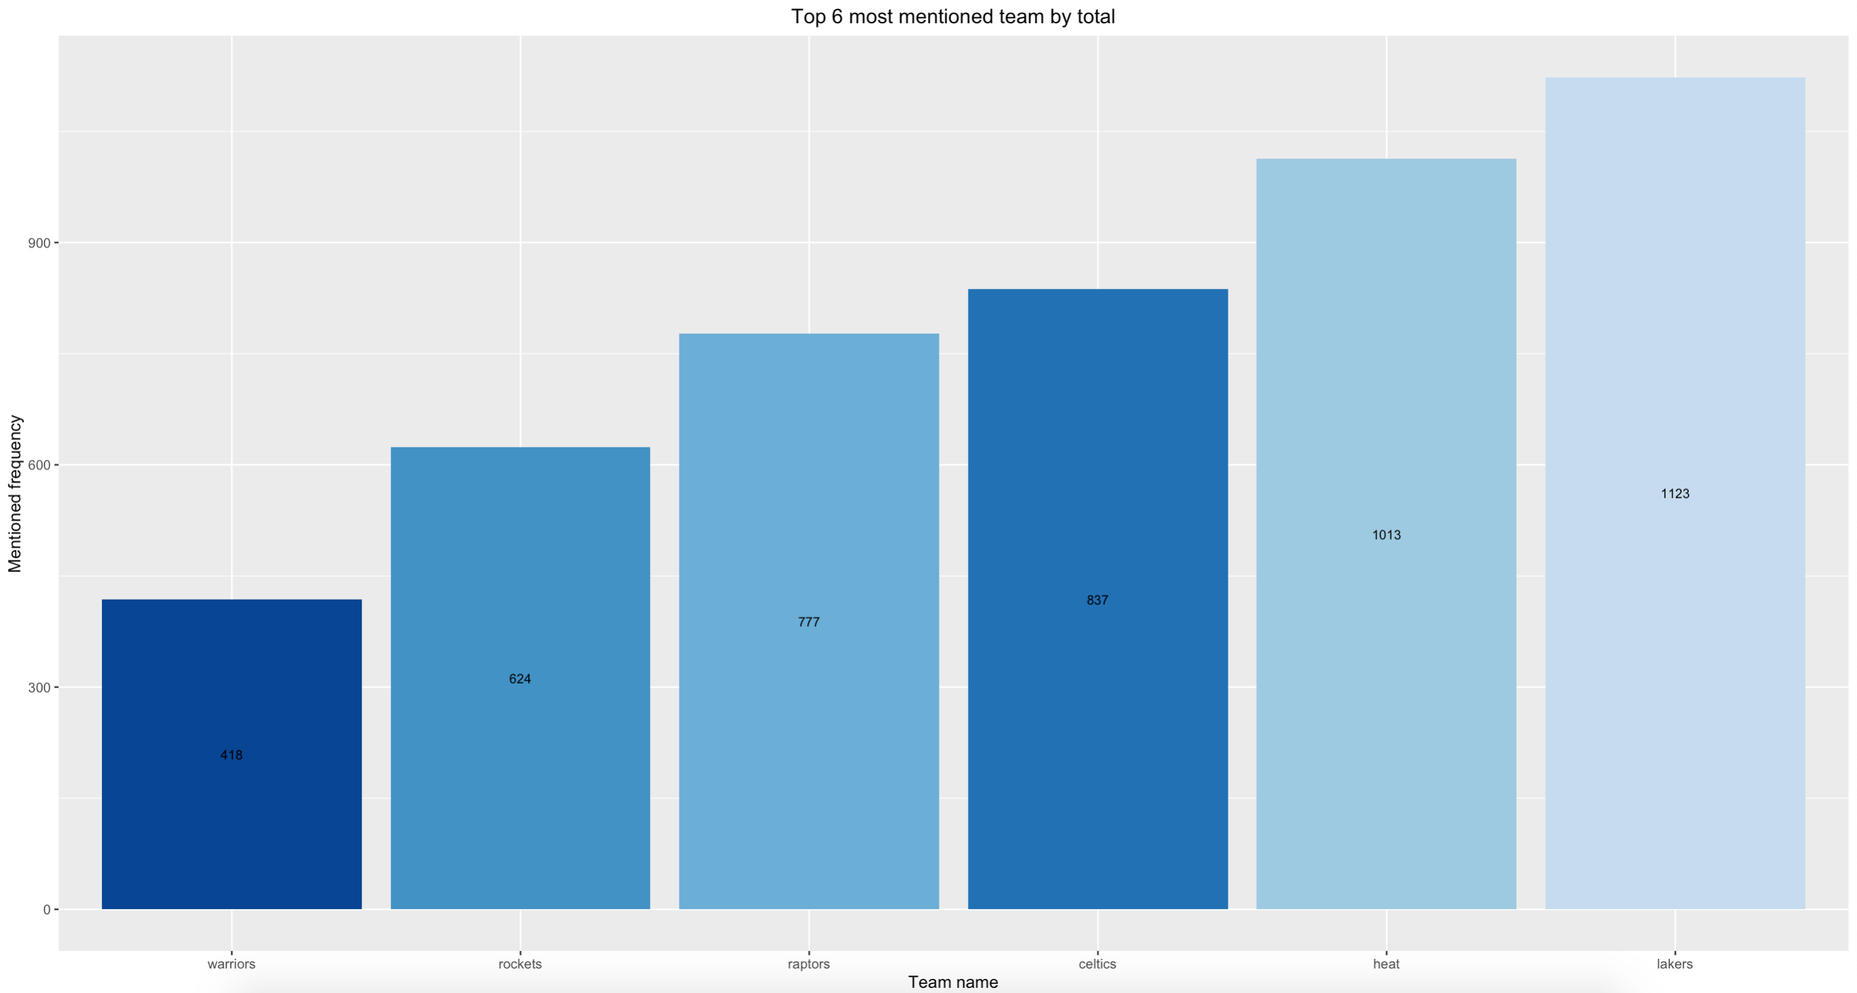
Most talked team

Slide 7
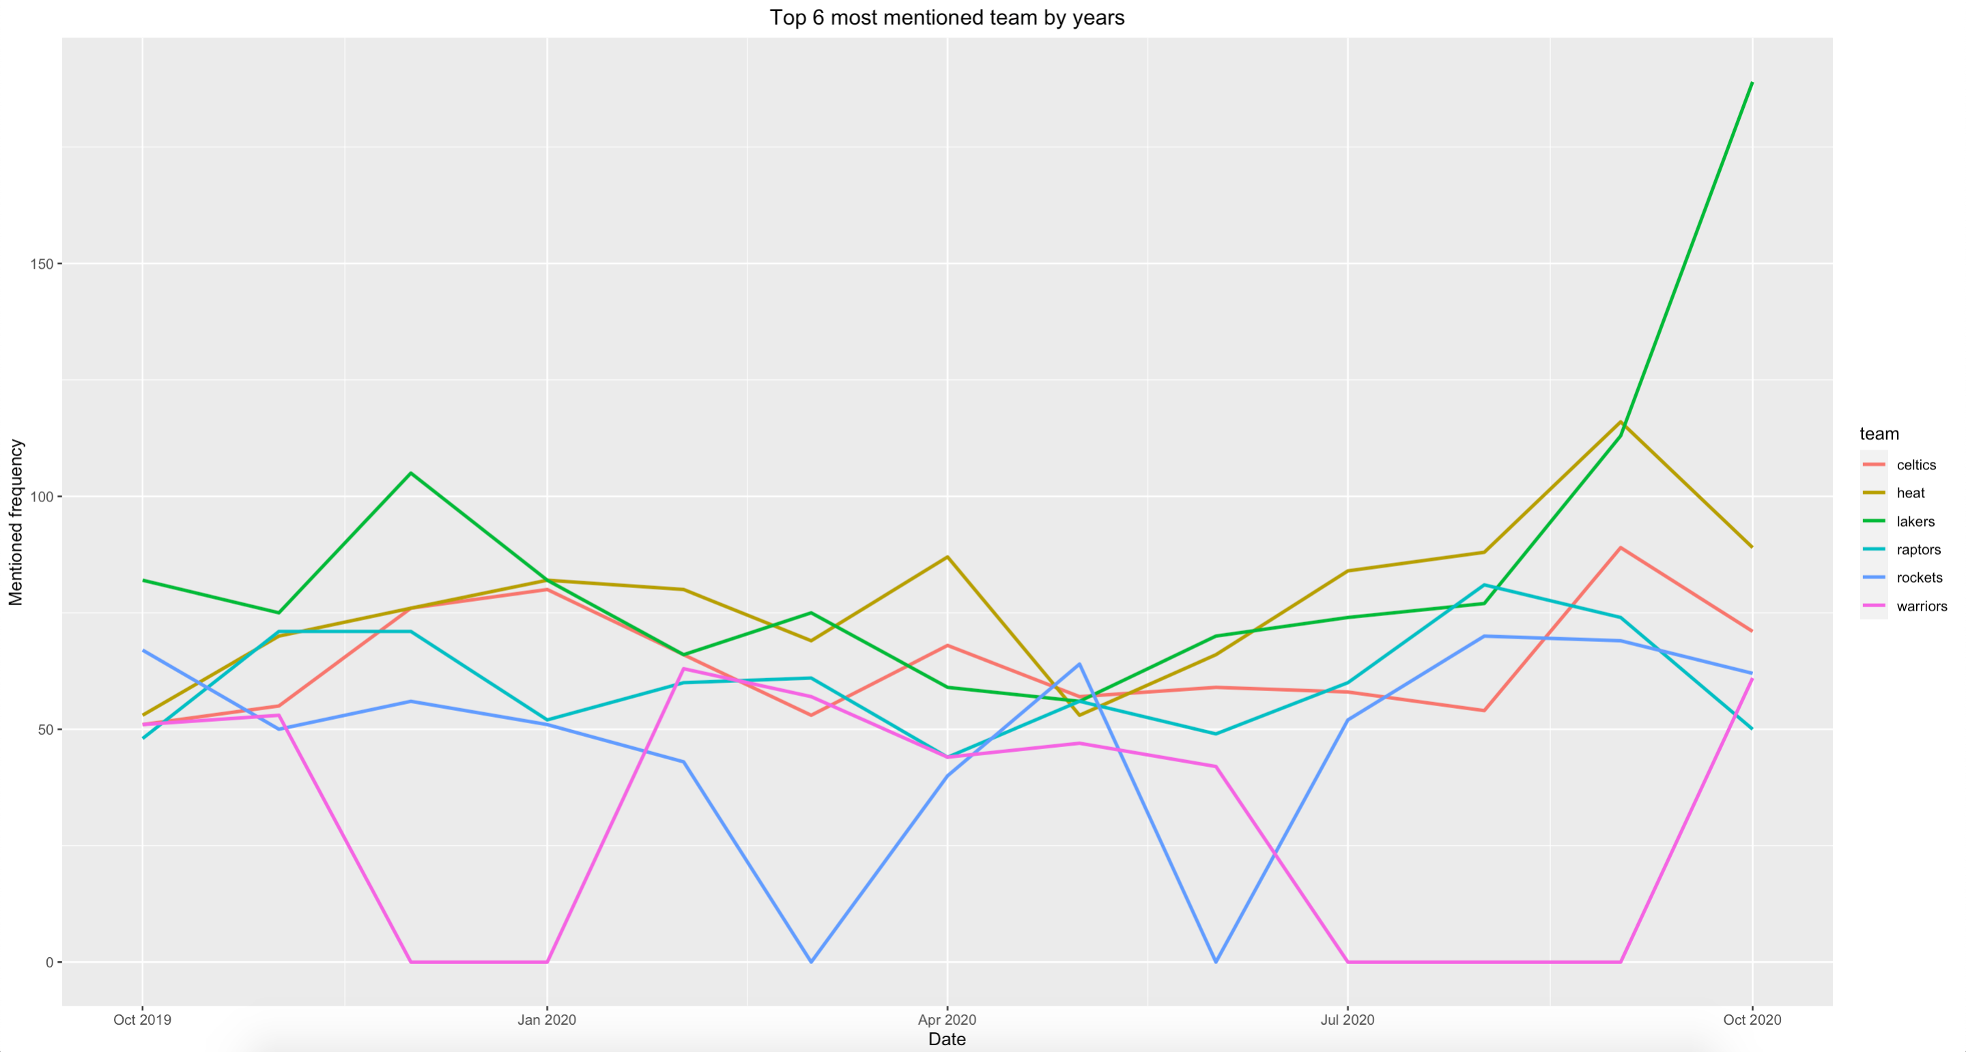
Most talked team

Slide 8
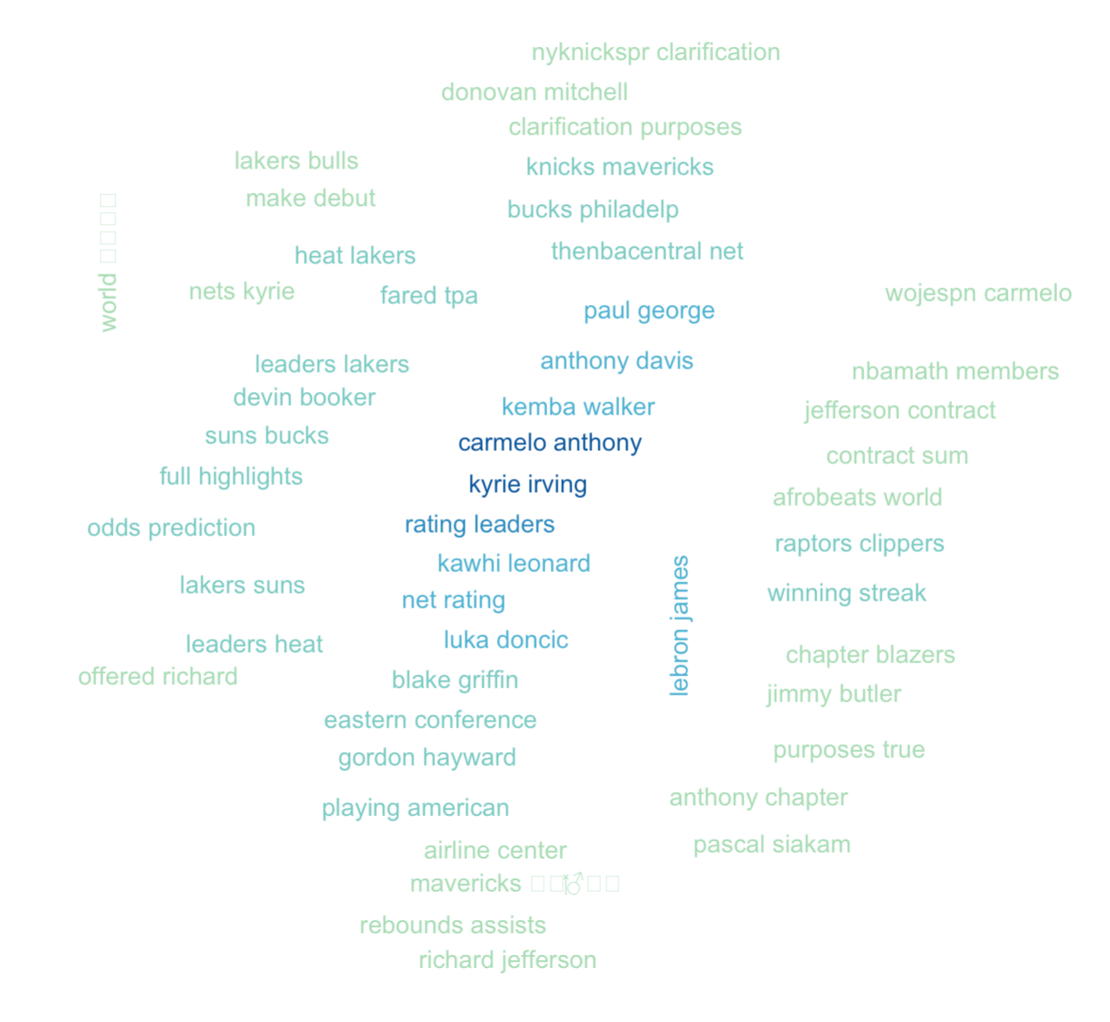
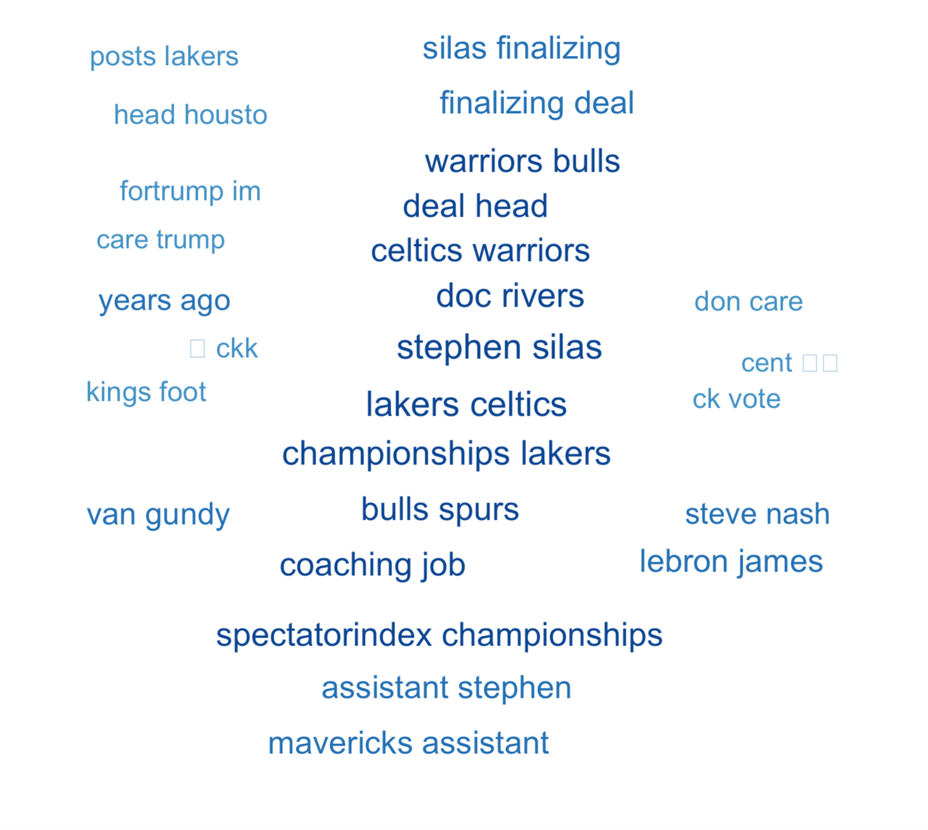
Lakers Nov 19 vs Oct 20

Slide 9
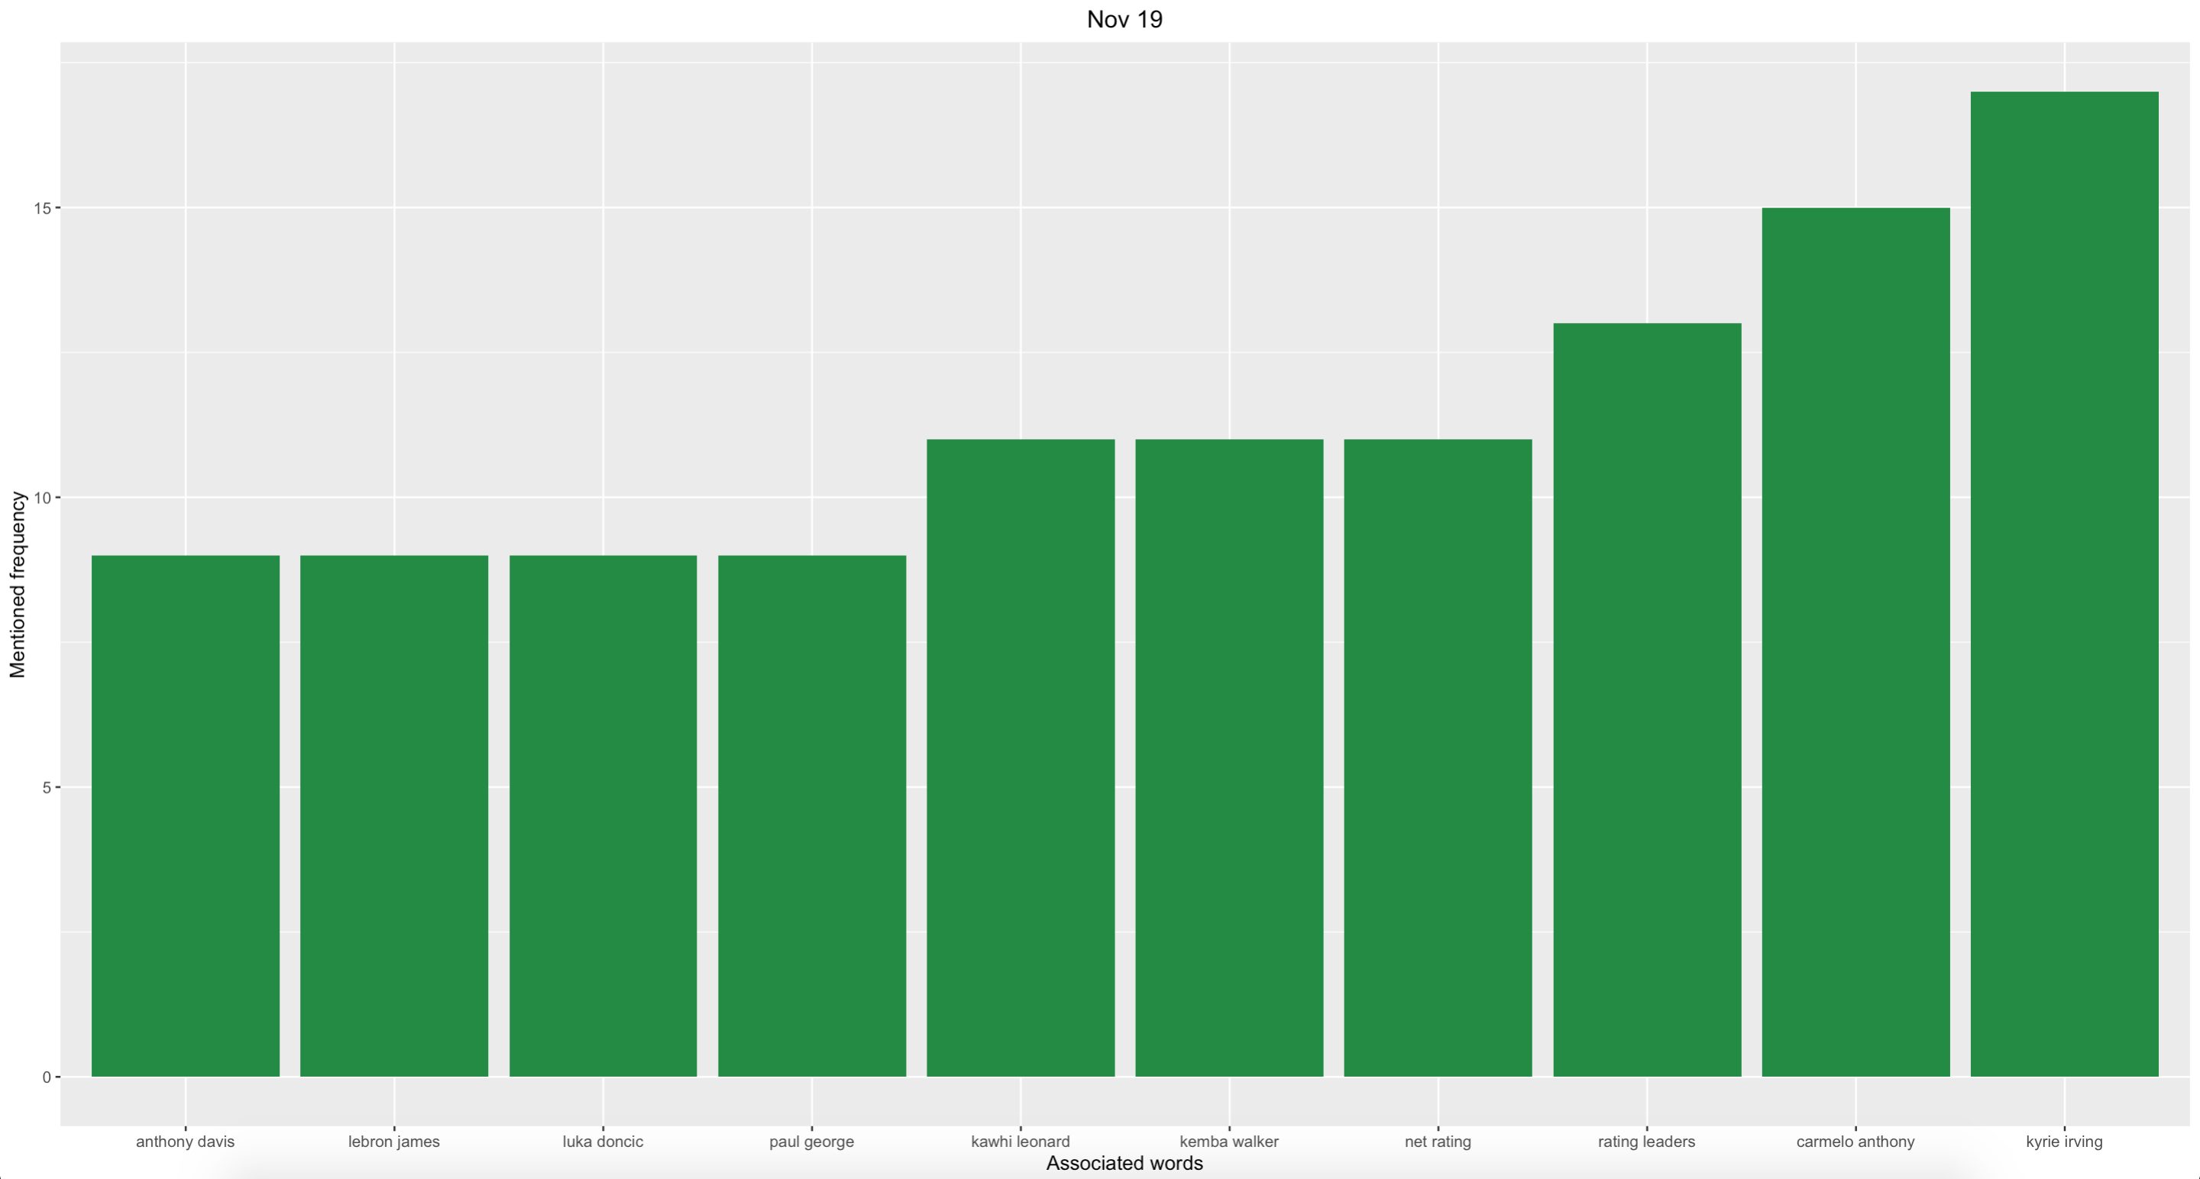
Lakers associated words

Slide 10
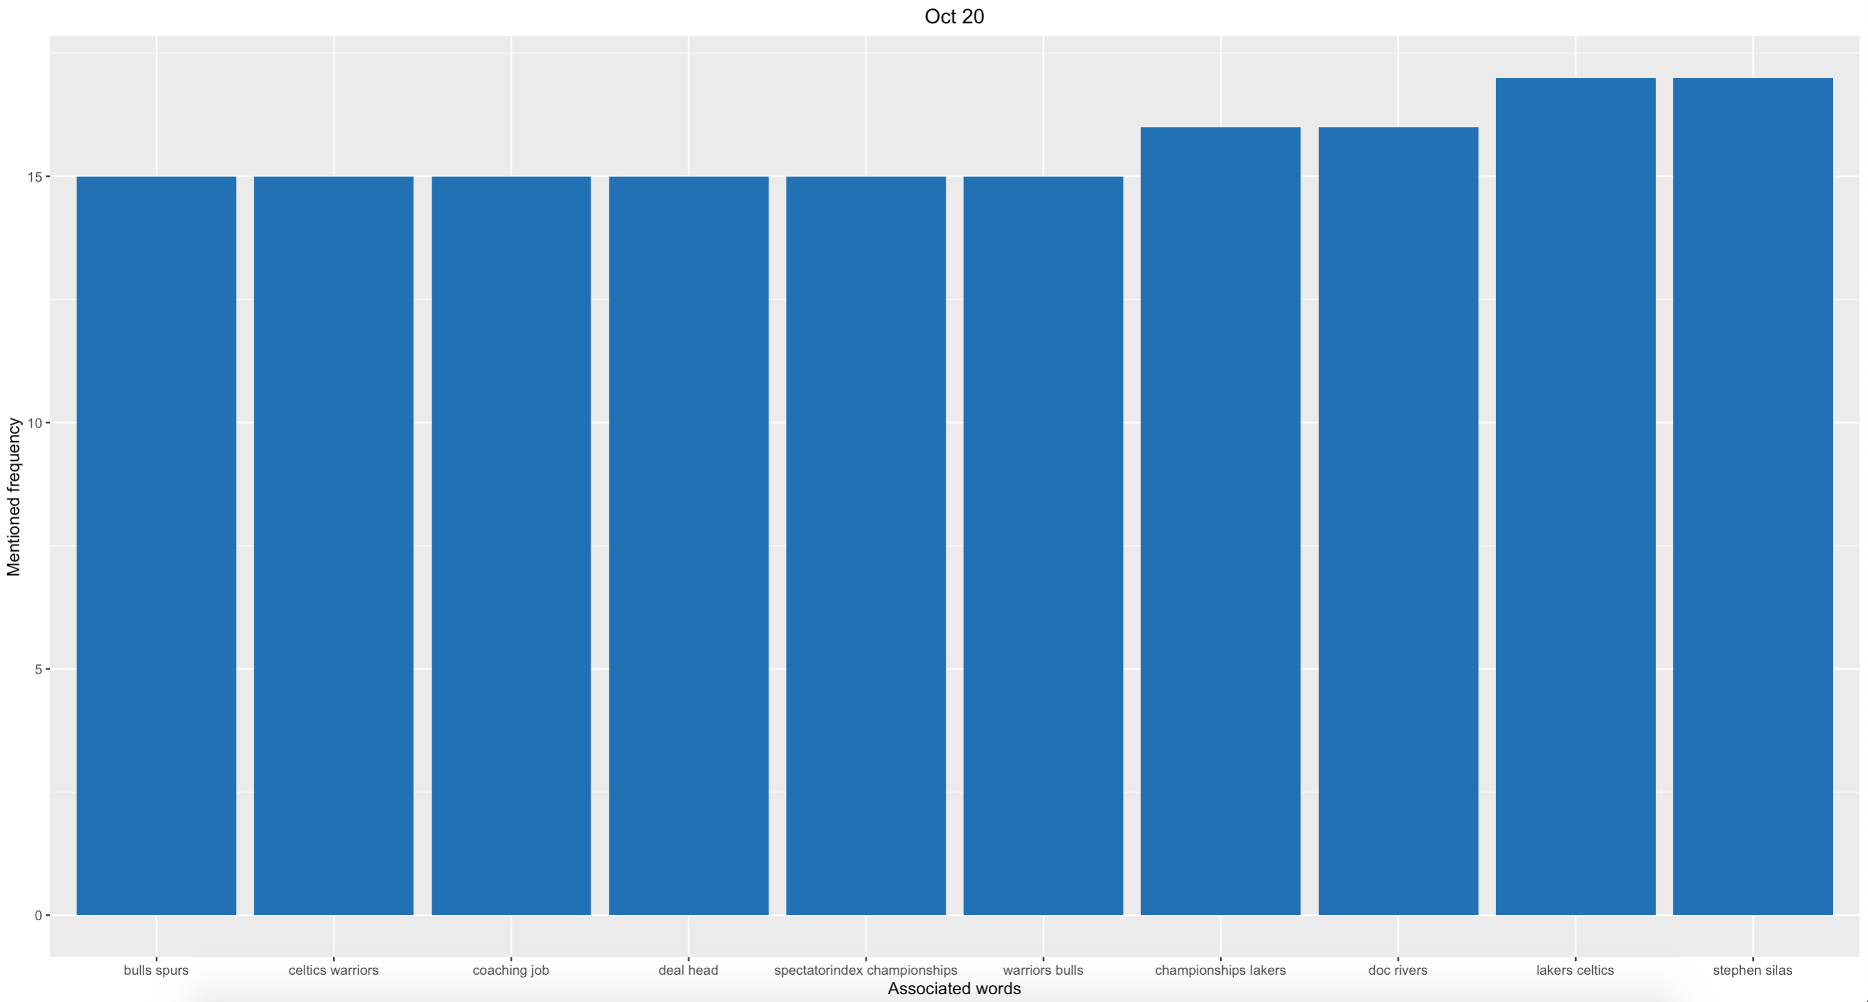
Lakers associated words

Slide 11
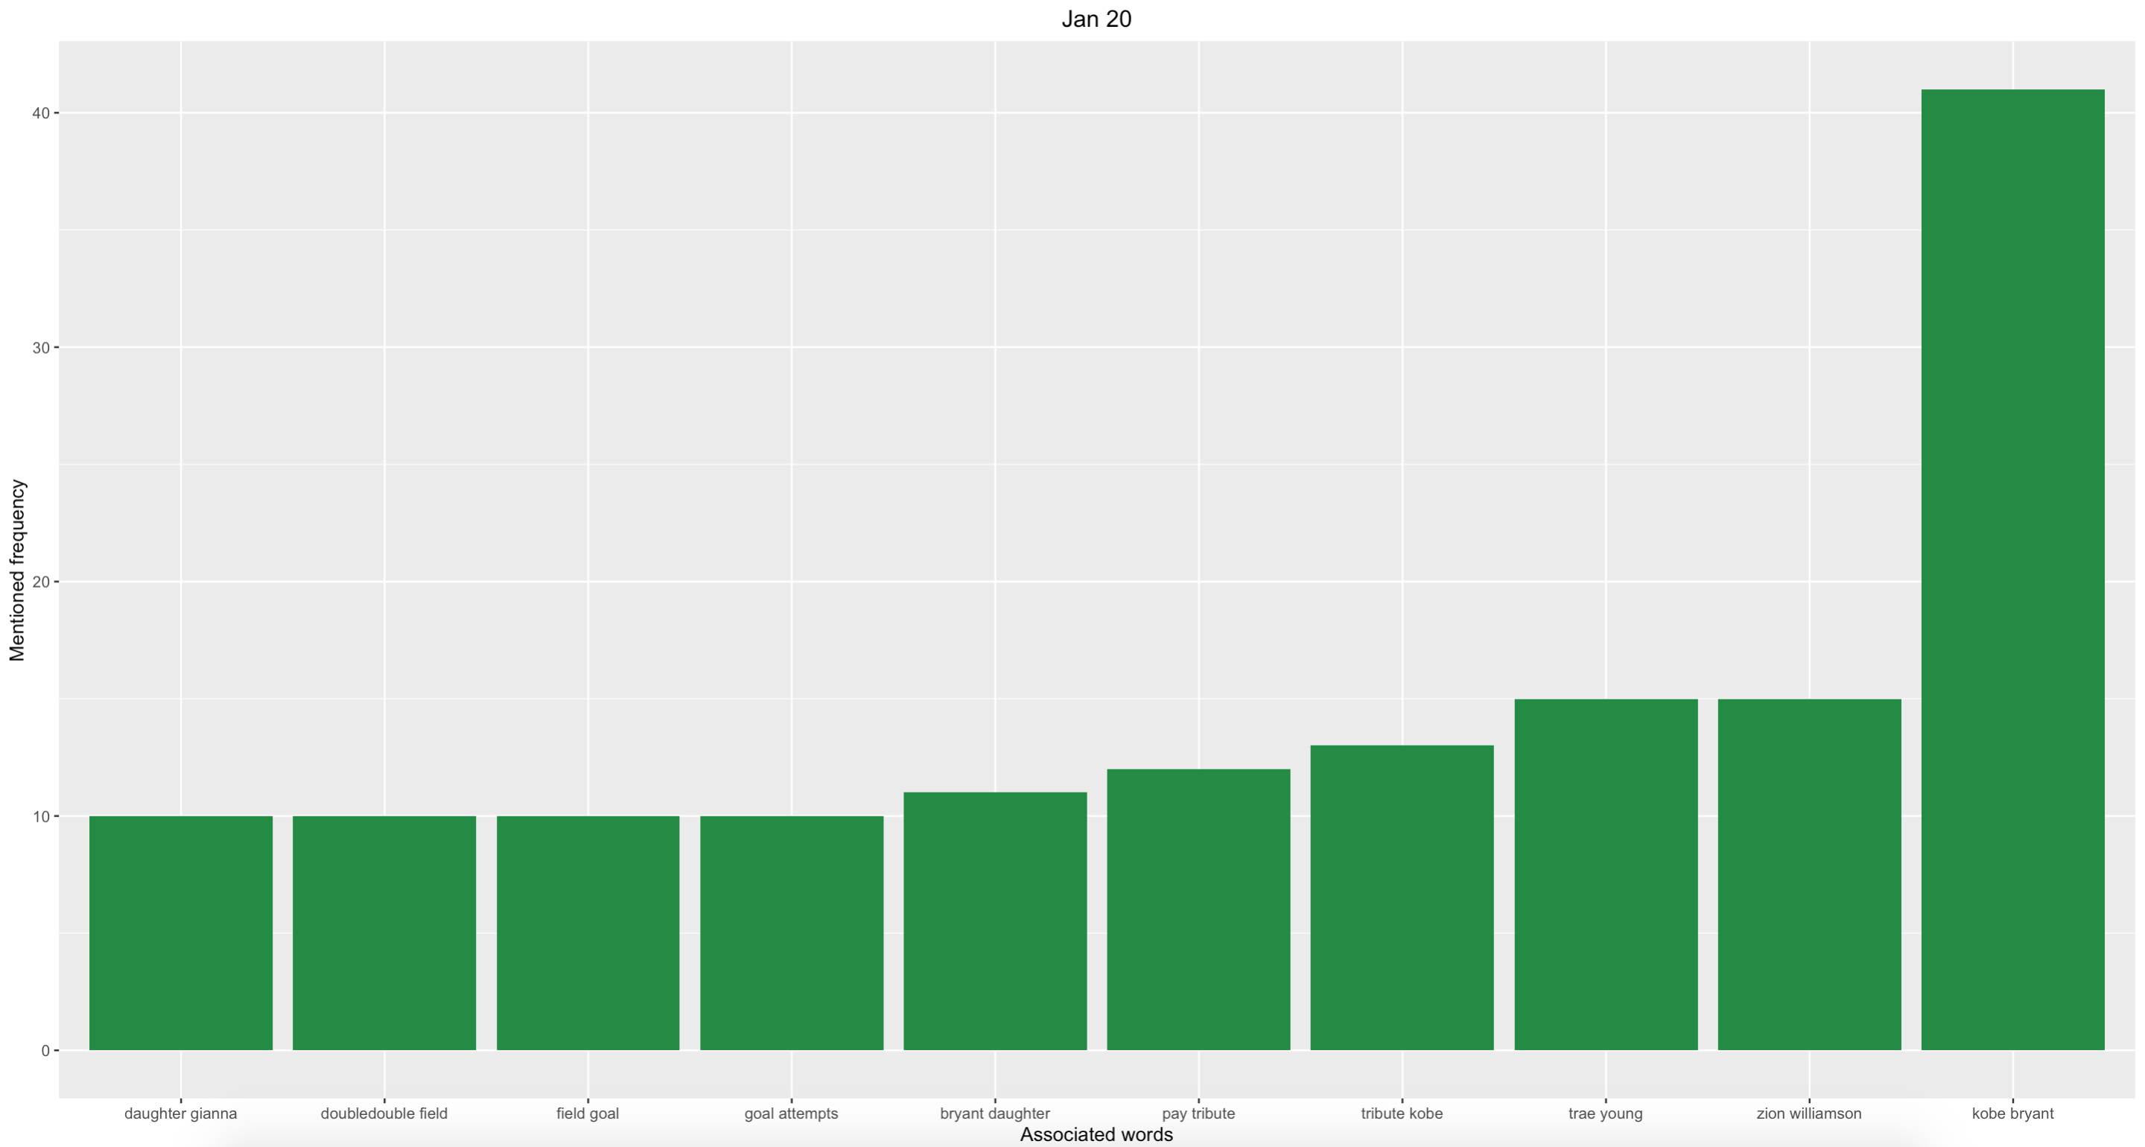
Warriors associated words

Slide 12
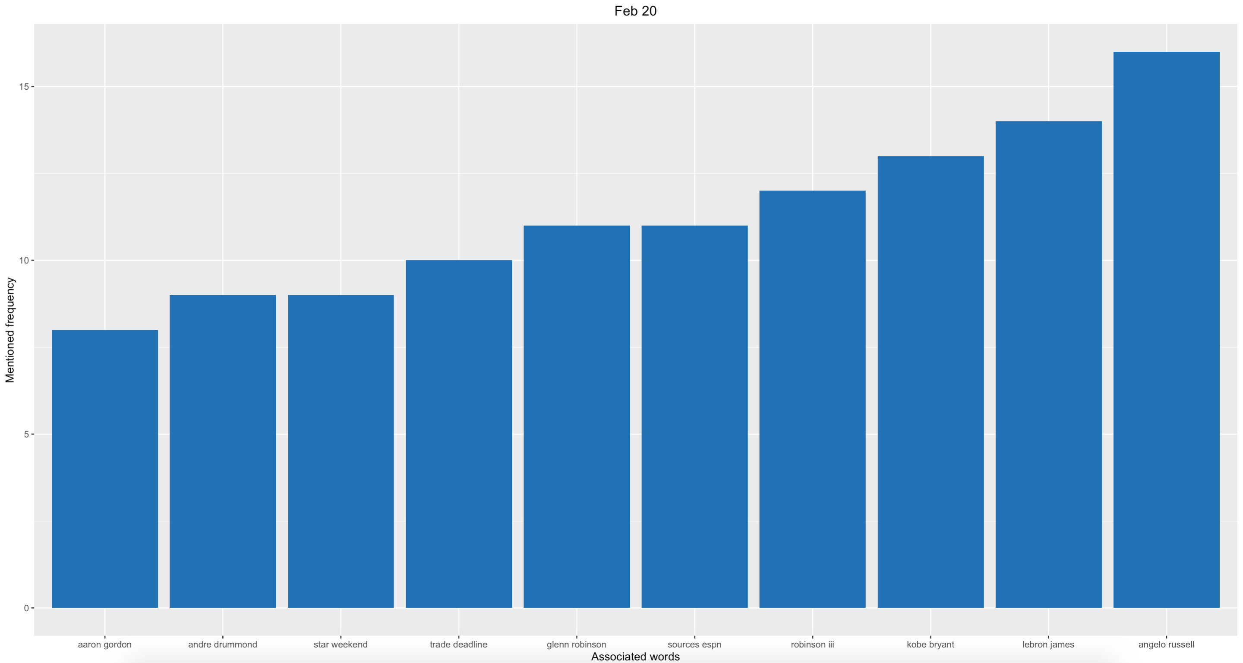
Warriors associated words

Slide 13
Emerging Topic

Slide 14
Emerging topics
Oct 19 - hong kong, kong shirts
Nov19 - kyrie irving, armelo anthony
Dec19 - luka doncic, james harden
Jan20 - kobe bryant, pay tribute
Feb20 - lebron james, kobe bryant
Mar20 - tested positive, positive coronavirus
Apr20 - michael jordan, years ago
May20 - michael jordan, years ago
Jun 20 - michael jordan, lives matter
Jul 20 michael jordan, serve voting"
Aug20 - donating arenasstadiums, teams donating
Sep20 - steve nash, eastern conference
Oct 20 - stephen silas, doc rivers

Slide 15
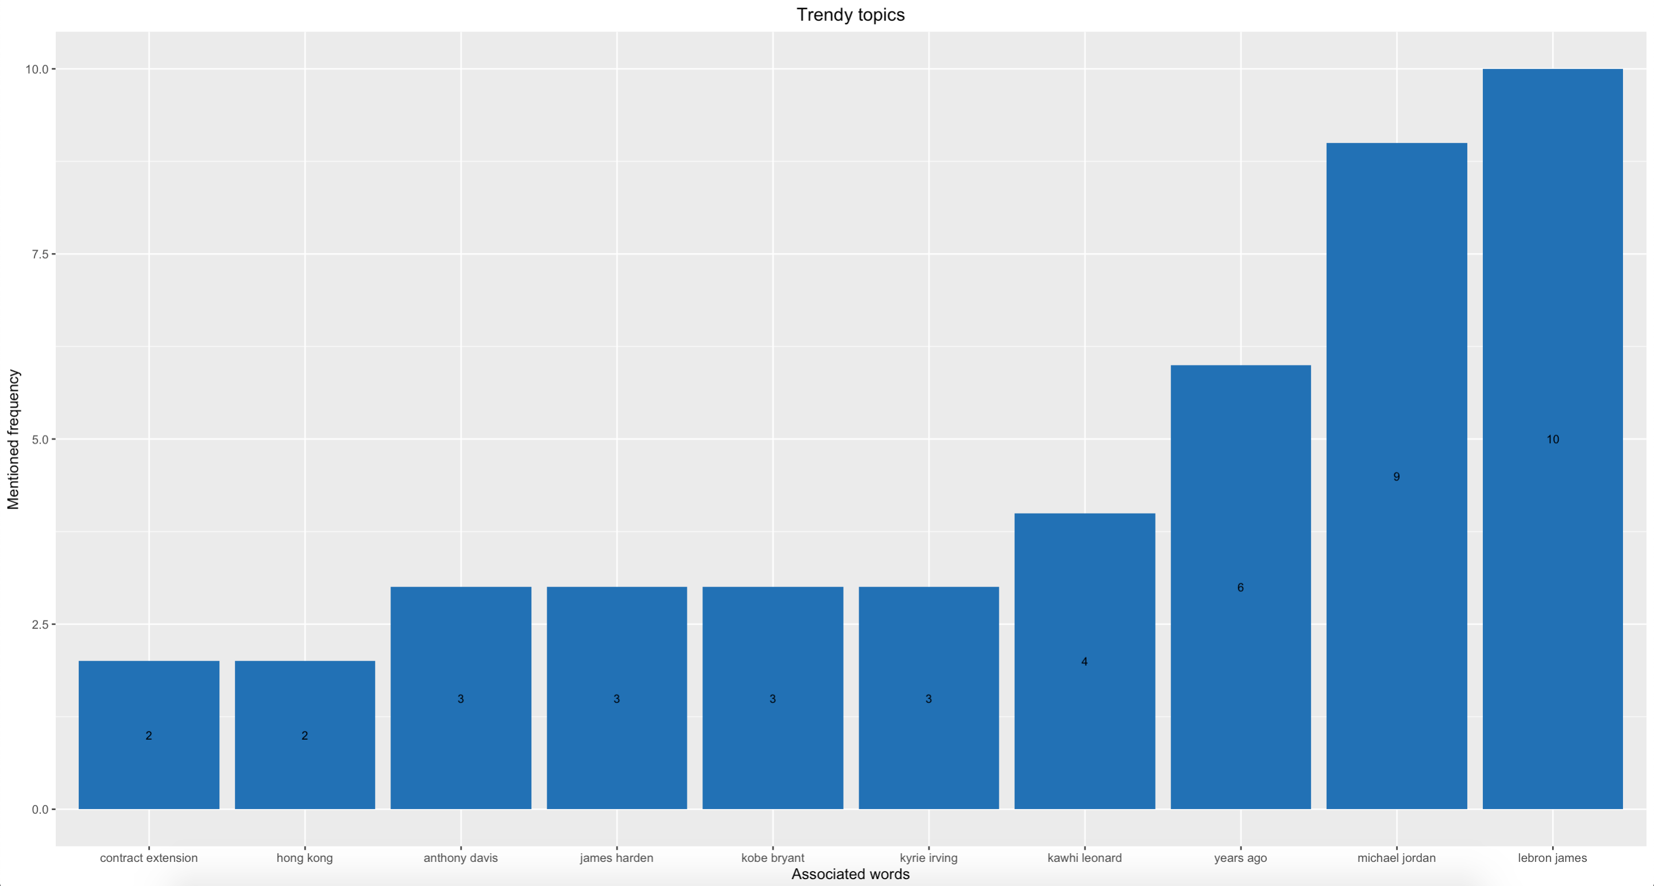
Trendy topics

Slide 16
Emerging topics - Total
take top 6 words to list and count times
top 5 time series
Oct 2019 - hong kong morey freedom
Coronavirus
Jul 2020 - First woman coach
Aug 2020 political donation, stadium polling avenue
oct 2020 dodgers Hebron

Slide 17
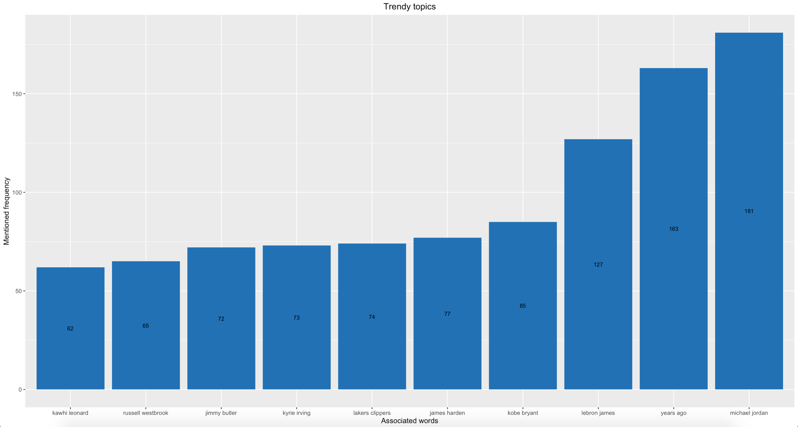
Nike associated words

Slide 18
Thank you for your attention!

